Slide 1

Coder - how to use
Date: Jun 29, 2023
Bao NGuyen
SDD/SWD/FSP1/RA FSP
Renesas Electronics Corporation

Slide 2
Agenda
Connection to the Coder box Page 03
Create workspace Page 05
How to use Page 11
Build and run Page 19
Debug Page 27

Slide 3
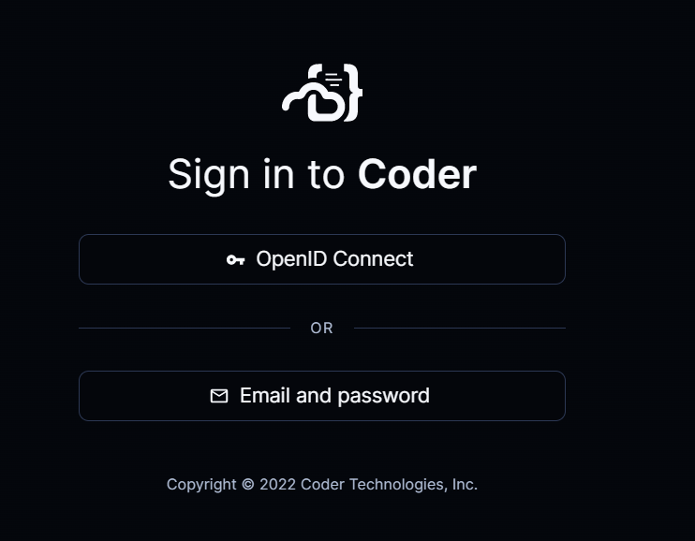
Connect to the coder box (build server)
To log in, employees will first need to have an account with https://gitlab.eng.renesas.com/
By using this GitLab from the global DevOps organization, we can utilize (effectively) LDAP credentials
If you do not have an account with this system, please create a request via ServiceNow
Once you have the GitLab account from above DevOps site, please log in to the Coder with "OpenID Connect“.
Developer can use all the Coder boxes. However, it is recommended to use the available ones at their region
US:
http://coder.rtpflexbuild1.rea.renesas.com
http://coder.rtpflexbuild2.rea.renesas.com
http://coder.mlpflexbuild1.rea.renesas.com
VN:
http://coder.hcmflexbuild001.rvc.renesas.com
http://coder.hcmflexbuild002.rvc.renesas.com
Singapore:
1. http://coder.resgfsp1.adwin.renesas.com

Slide 4
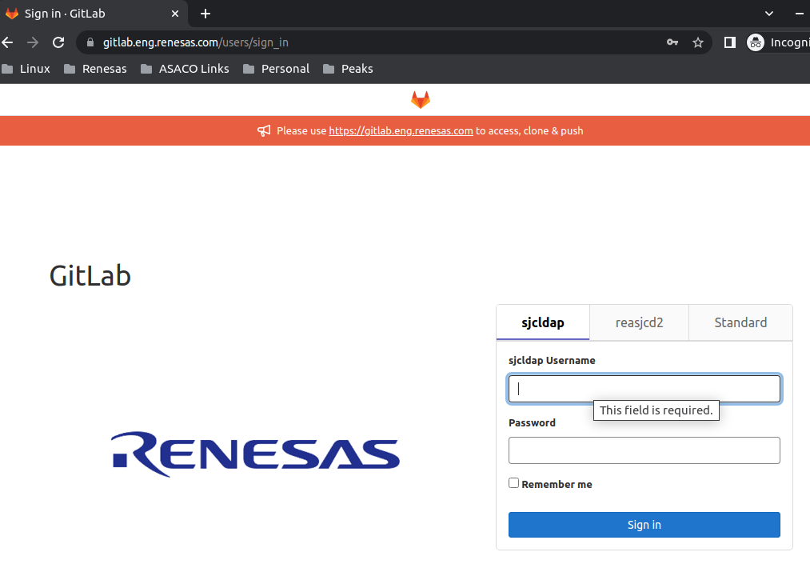
Connect to the coder box (cont.) (build server)
You will be redirected to the DevOps GitLab for sign in (select 'sjcldap' tab). Use your Renesas email address for the username and your Renesas email address password for the password

Slide 5
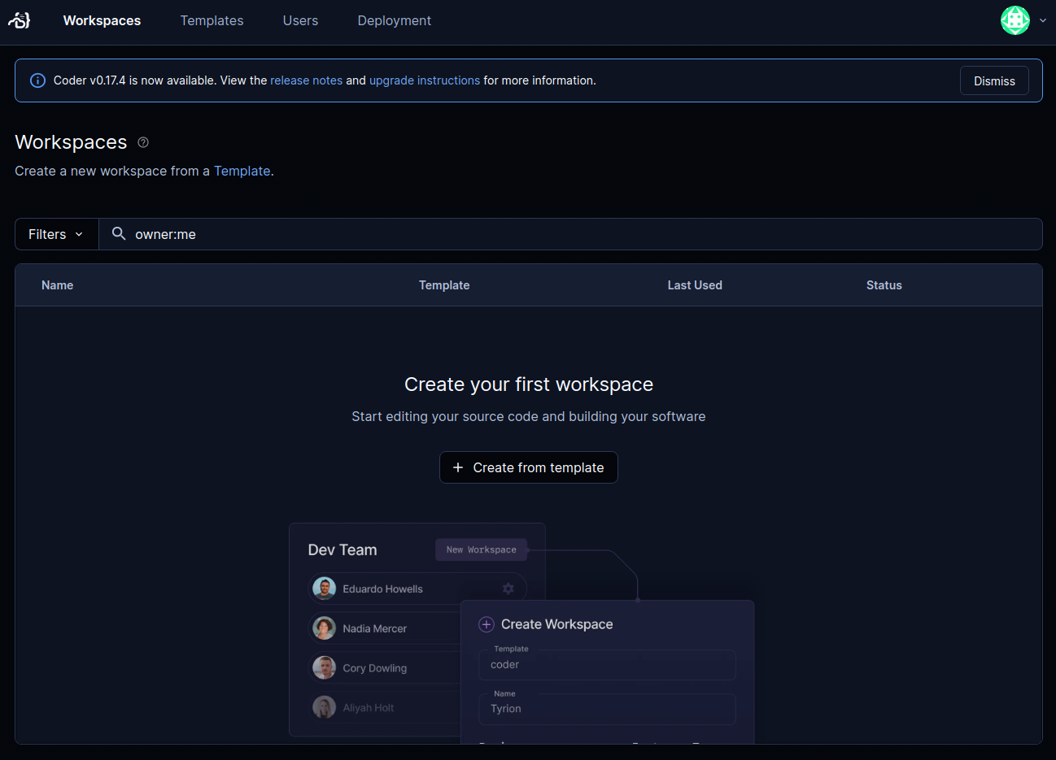
Create workspace create from template
Initially, you will have no workspaces… select “Create from template”

Slide 6
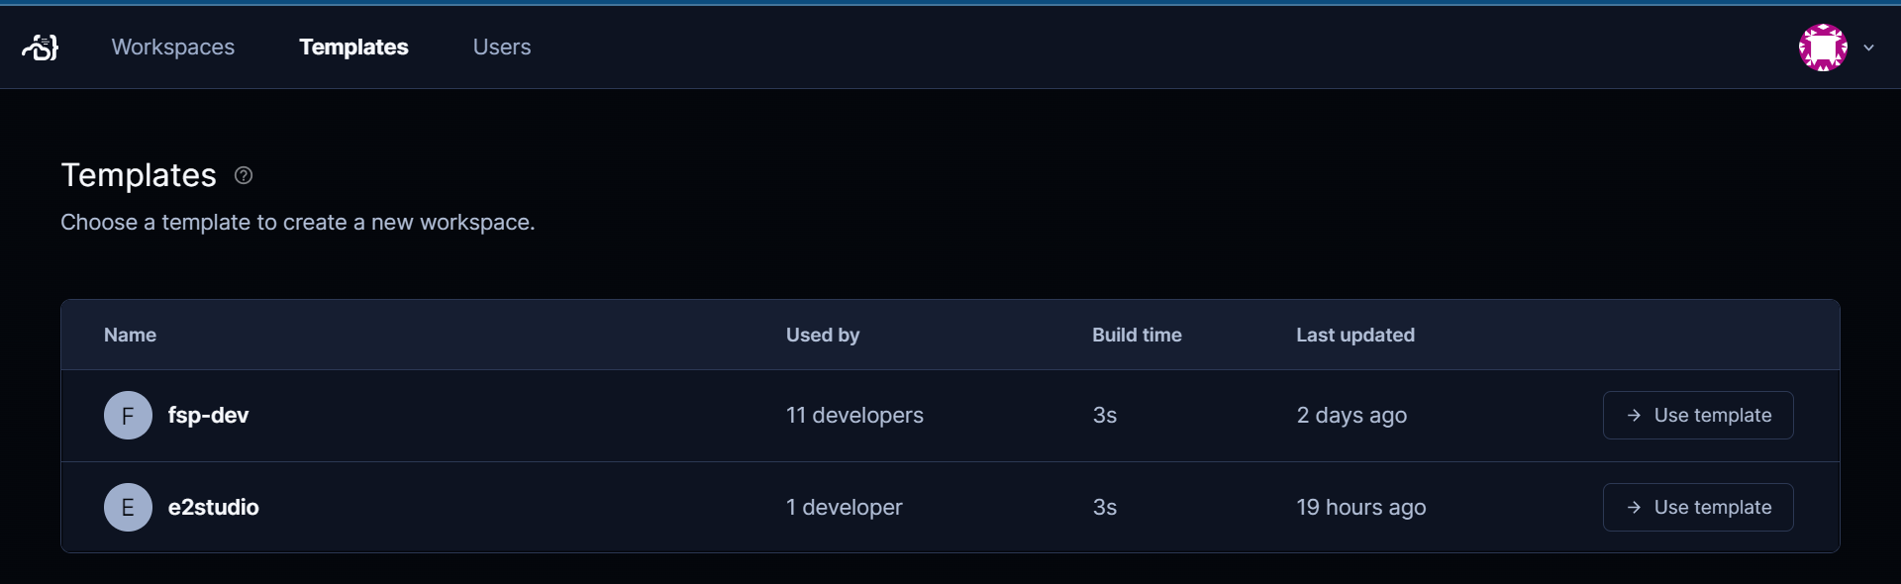
Create workspace choose the template
Currently we only have two templates, we will add more as needed, select “Use template” In VN, we only have one template ‘fsp-dev’ (re-used from the one of US to unify the same docker image)

Slide 7
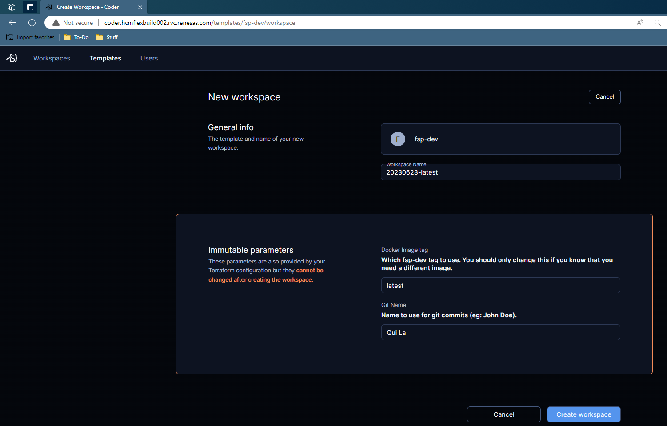
Create workspace choose the docker image
Fill in fields as appropriate, (must change Git Name) then “Create workspaces”
means the latest commit from the ‘develop’ branch on RA peaks repos
Developer can freely checkout to other branches

Slide 8
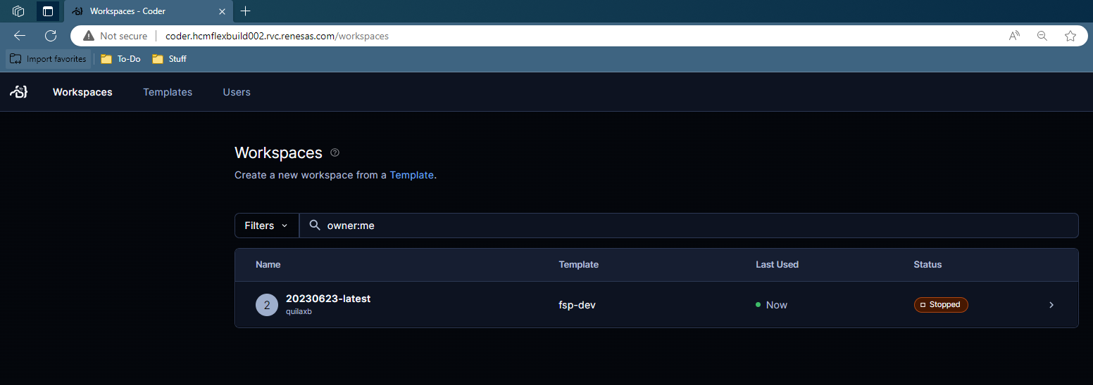
Create workspace isolated workspace
The created workspace is based on the template and is directly controlled by the creator (not shared)
- This is like docker image and docker container analogy

Slide 9

Create workspace start the workspace
You can see all your workspaces on “Workspaces” Each workspace is isolated (like multiple docker containers)

Slide 10
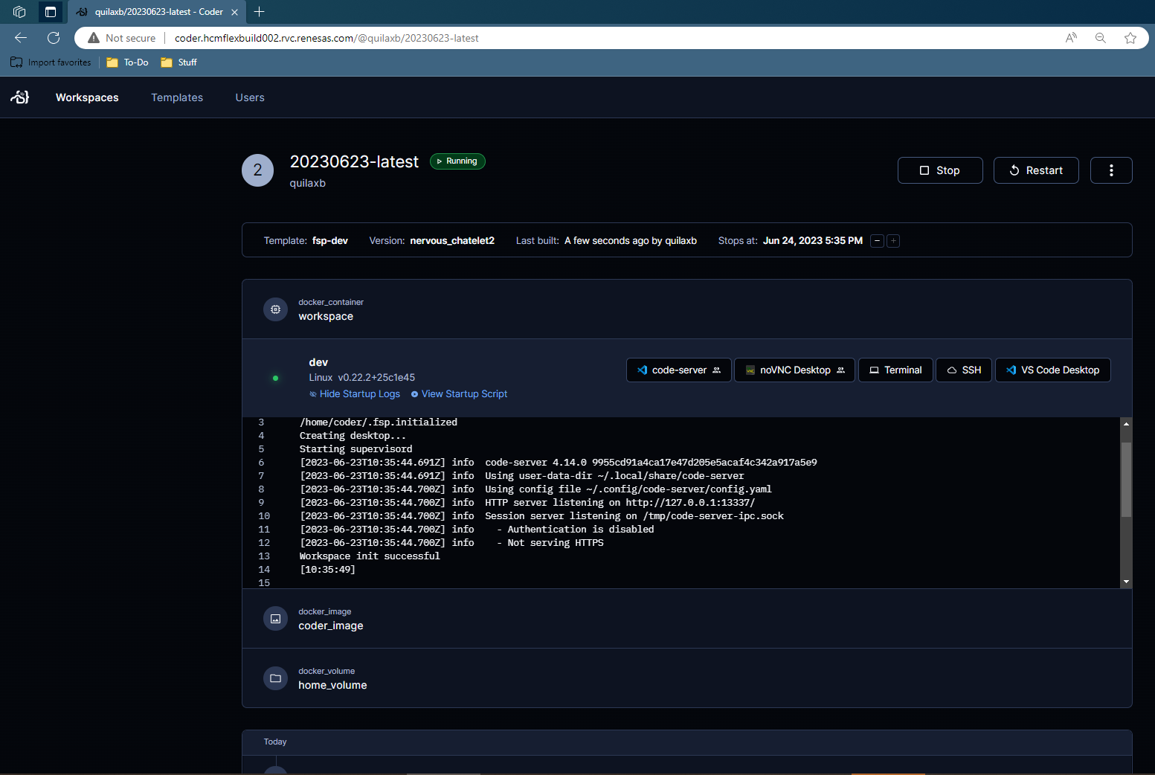
Create workspace using method
For a given workspace, there are multiple ways to interact with it. Once a workspace is created, the development repos (e.g., RA peaks repos) will be located at </home/coder/workspace/peaks>

Slide 11
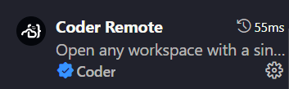
How to use VS Code Desktop
[VS Code Desktop] launches local VS Code and connects to Coder (VS Code needs to be updated to later version if any to install Coder Remote extension successfully)

Slide 12
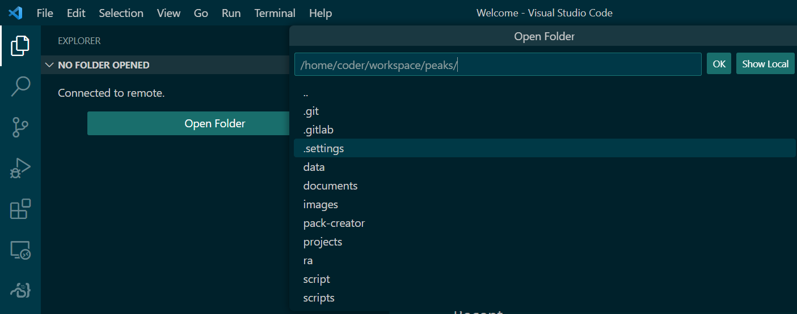
How to use VS Code Desktop
Open the “peaks’ from [Open Folder]

Slide 13
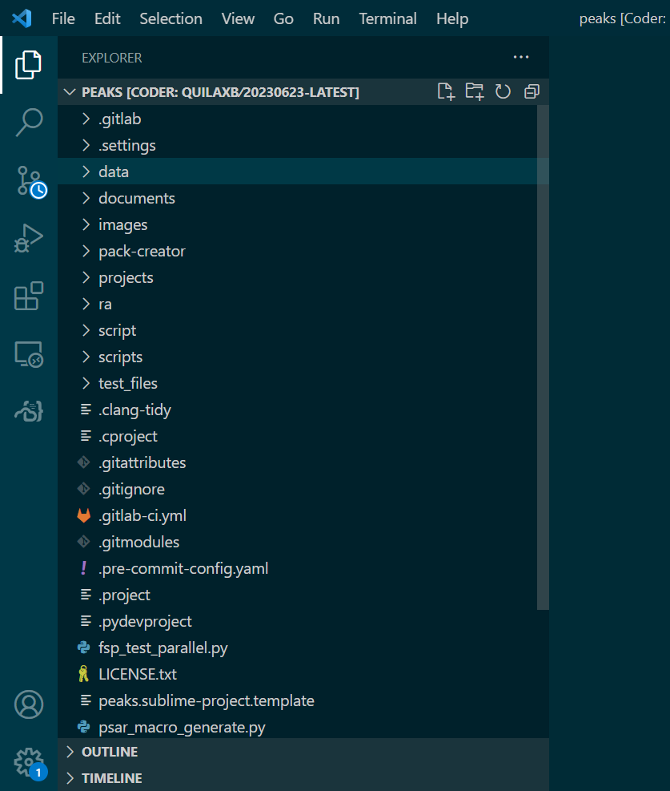
How to use VS Code Desktop

Slide 14
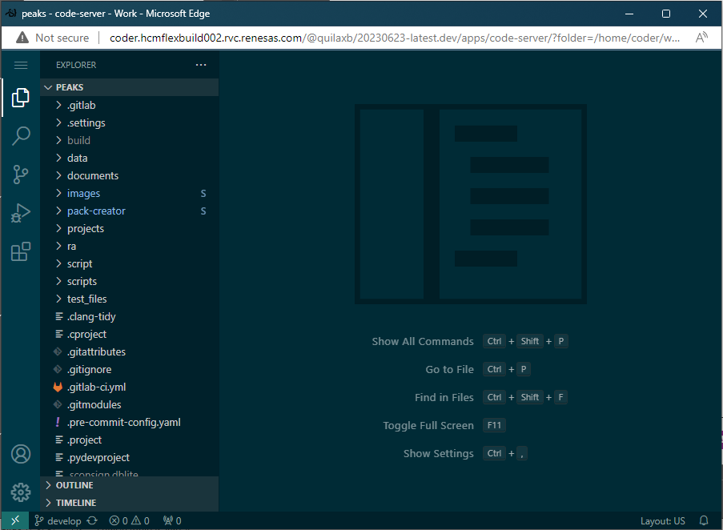
How to use code-server
[code-server] launches a web-based VS Code instance served by the Coder box
- No software required installed locally

Slide 15
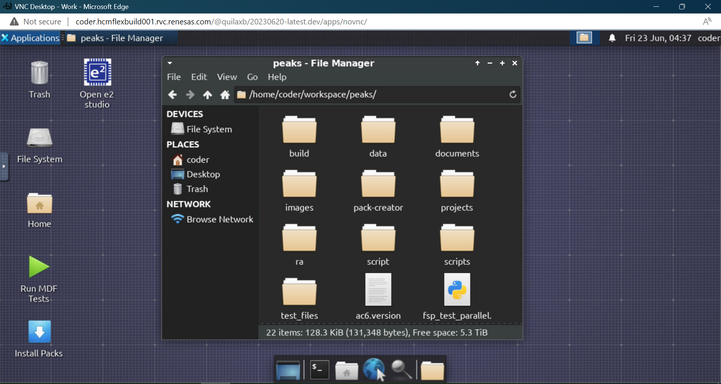
How to use no-vnc desktop
[noVNC Desktop] launches a web-based VNC viewer
- No software required installed locally

Slide 16
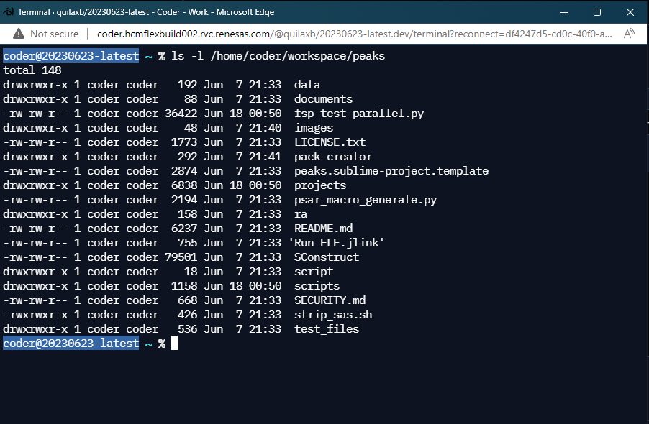
How to use terminal
[Terminal] launches a web-based terminal
- No software required installed locally

Slide 17
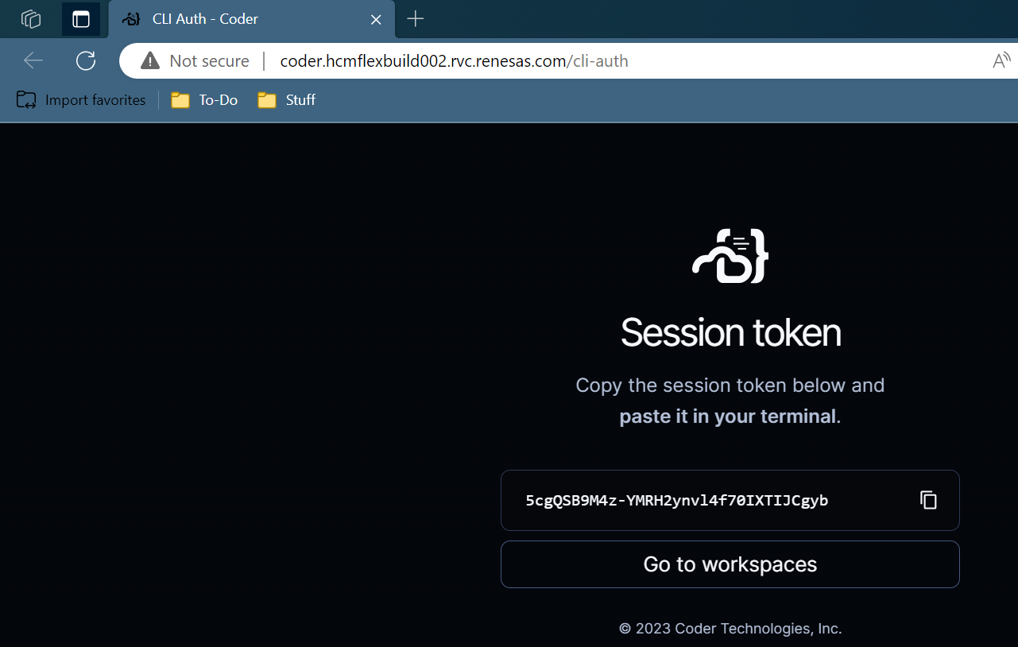
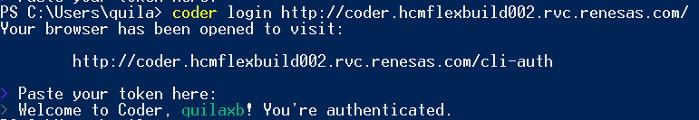
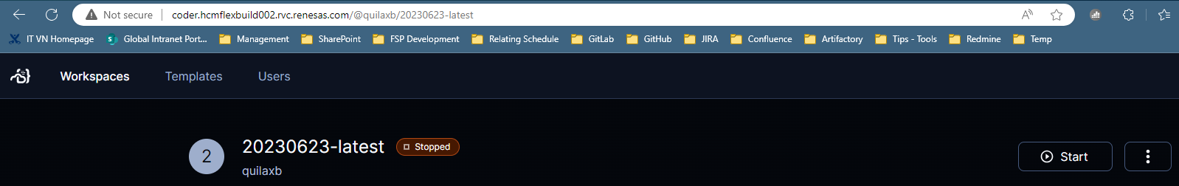
How to use ssh
[SSH] provides instructions on how to connect via SSH
Coder CLI and SSH client required locally
Download and install Coder CLI: Install file – Windows
Then ssh to the workspace…
1
2
3
4

Slide 18
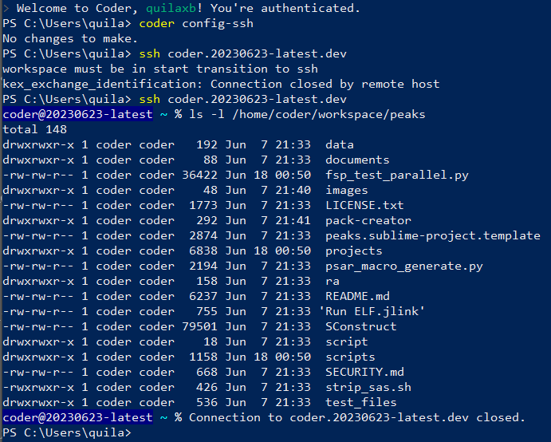
How to use ssh
5
6
means the workspace “20230623-latest“ was not started yet

Slide 19
Build and run (ra unity test)
Navigate to the “peaks” folder and use ‘scons’ to build:
$ scons --build=<module> --compiler=<compiler> --board=<board>
(supported compiler: gcc, iar and ac6)
More build options can be specified. E.g.:
$ scons -k --cache-disable --build=r_cgc --compiler=gcc --board=ra4m3_ek --static_analyze=export

Slide 20
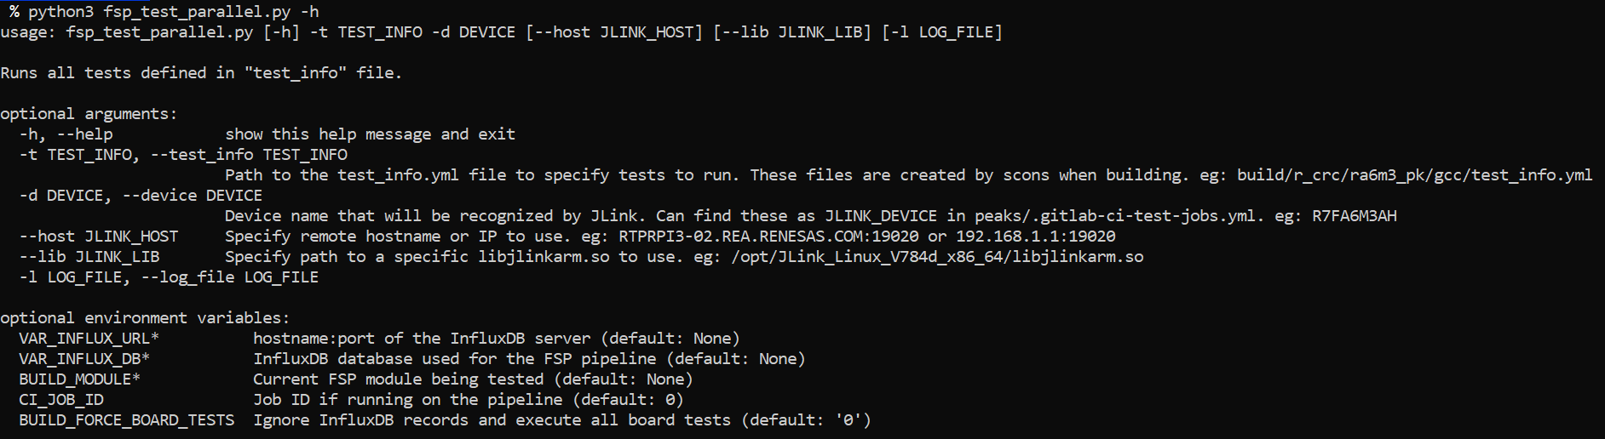
Build and run (ra unity test)
Build source Unity Test with Command
Load to Jlink Server: Use script fsp_test_parallel.py
Ex:
python3 fsp_test_parallel.py -t build/r_cgc/ra4m3_ek/gcc/test_info.yml -d R7FA4M3AF --host 10.231.9.2:19022

Slide 21
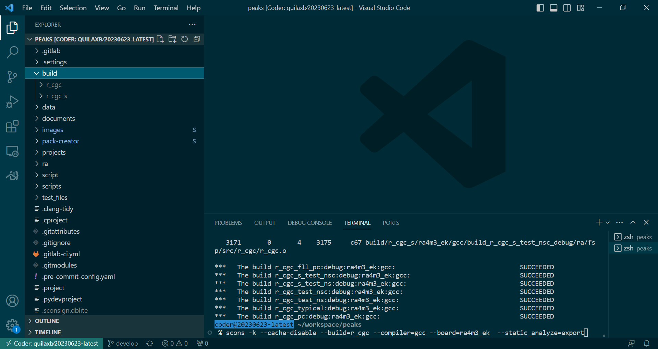
Build and run (ra unity test) – VS Code desktop

Slide 22
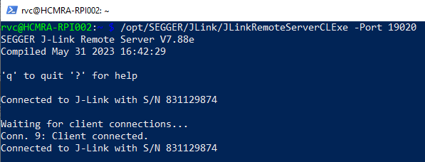
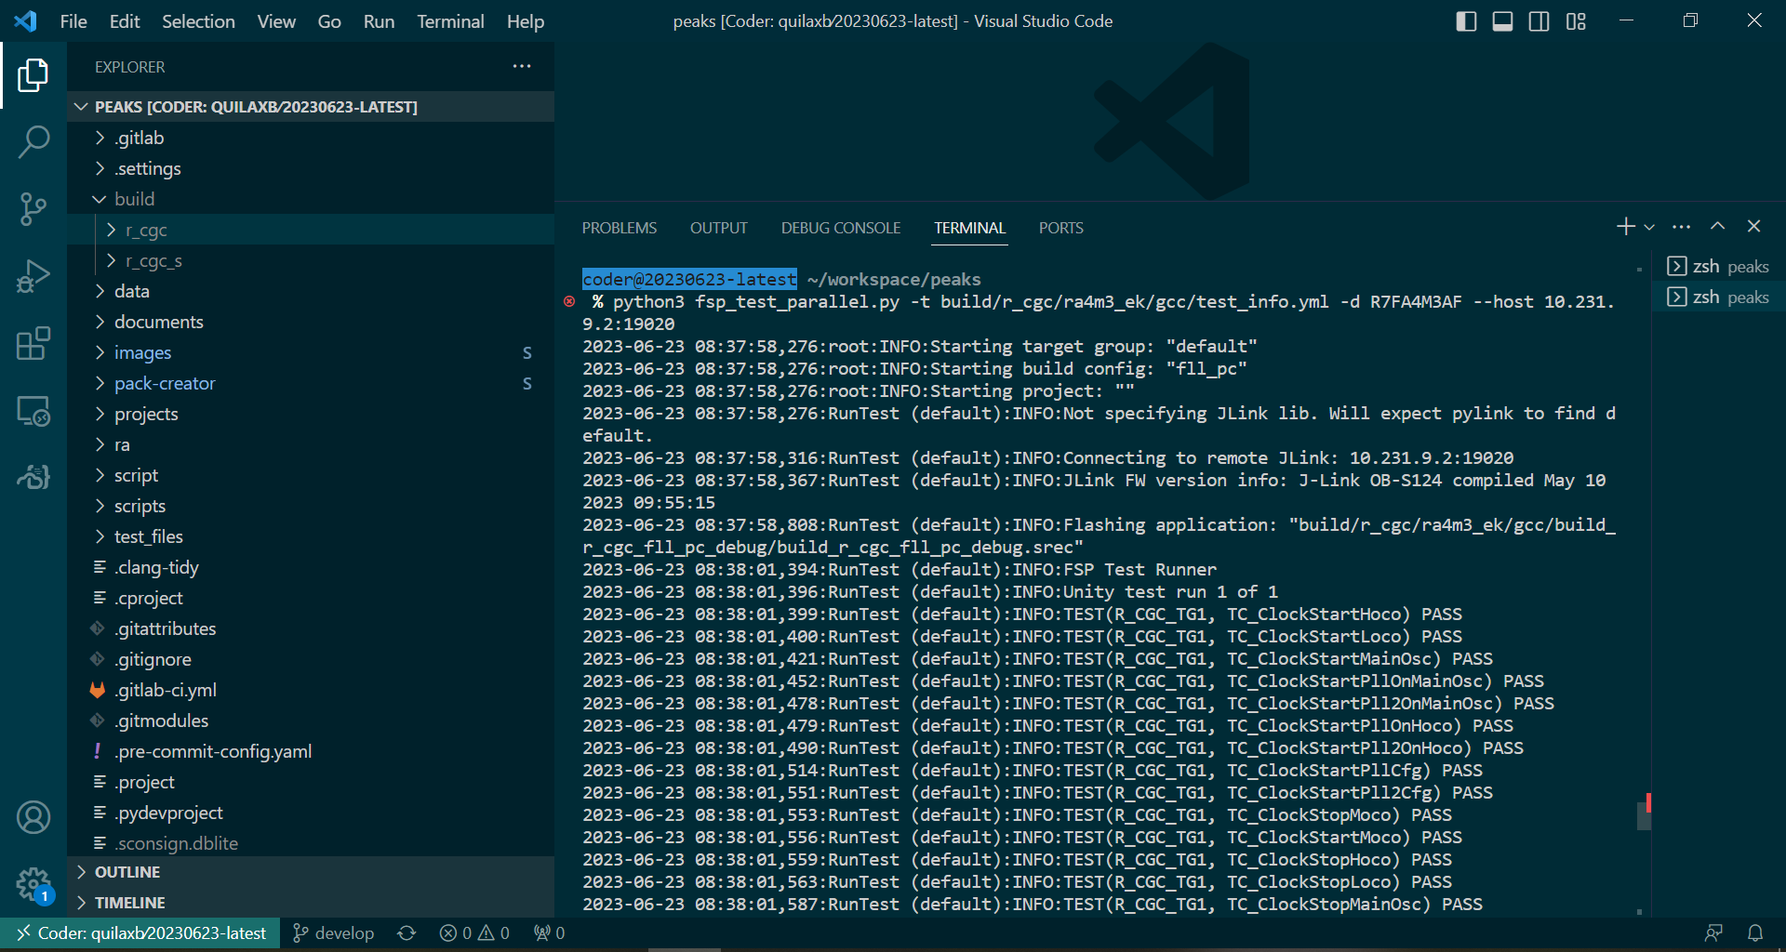
Build and run (ra unity test) – VS Code desktop
1
Open the connection between Pi and board by JLinkRemoteServer which is installed on the Pi:
ssh to the Pi and run the command ‘JLinkRemoteServerCLExe’
E.g.: $ /opt/SEGGER/JLink/JLinkRemoteServerCLExe -Port 19020
Then run the test
2

Slide 23
Build and run (ra unity test) – coder-server
Similar to [VS Code Desktop]

Slide 24
Build and run (ra unity test) – no-vnc desktop
Similar to [VS Code Desktop]

Slide 25
Build and run (ra unity test) – terminal
Similar to [VS Code Desktop]

Slide 26
Build and run (ra unity test) – ssh
Similar to [VS Code Desktop]

Slide 27
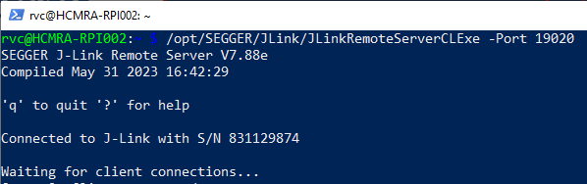
debug (by e2studio on no-vnc desktop)
Open the connection between Pi and board by JLinkRemoteServer which is installed on the Pi:
ssh to the Pi and run the command ‘JLinkRemoteServerCLExe -Port <port>’
‘-SelectEmuBySN <JLink S/N>’ should be added in case the Pi has some J-Link devices connecting to
E.g.: $ /opt/SEGGER/JLink/JLinkRemoteServerCLExe -Port 19020

Slide 28
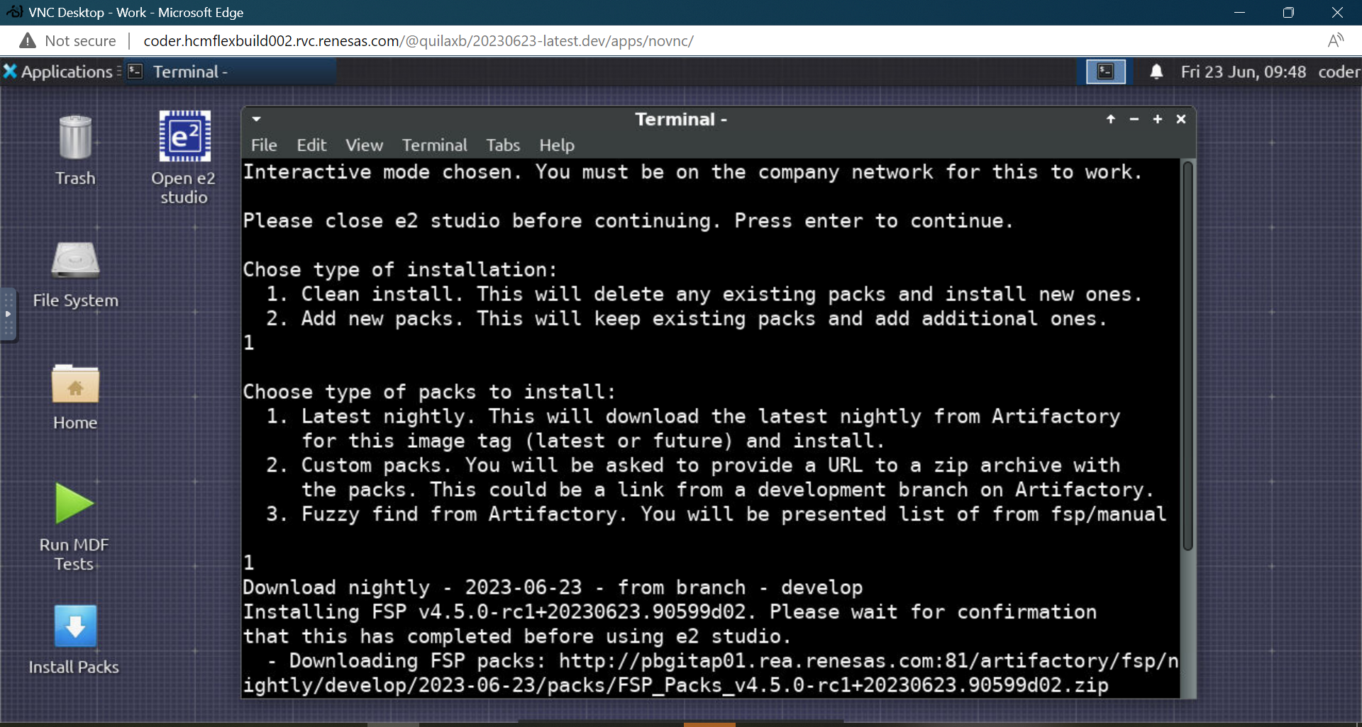
debug (by e2studio on no-vnc desktop)
Open [noVNC Desktop] from the workspace
Execute [Install Packs] and choose the suitable options

Slide 29
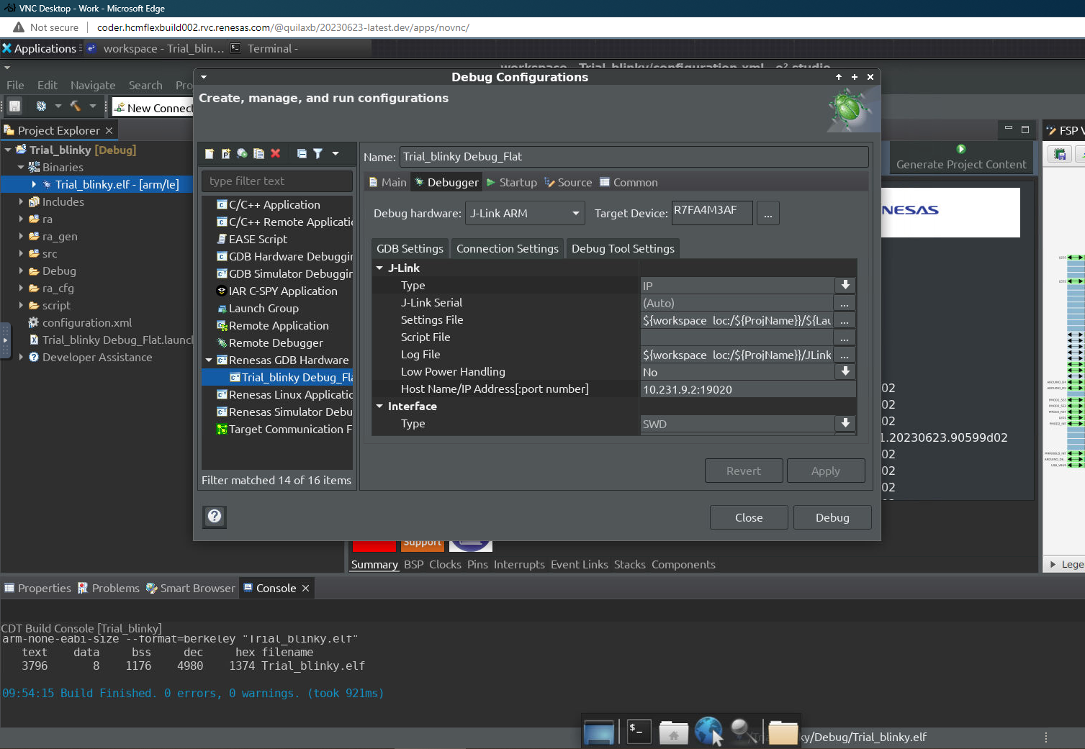
debug (by e2studio on no-vnc desktop)
Execute [open e2 studio]
Create and build a project
Modify debug configuration to TCP/IP connection to use JLinkRemoteServer
Then Debug

Slide 30
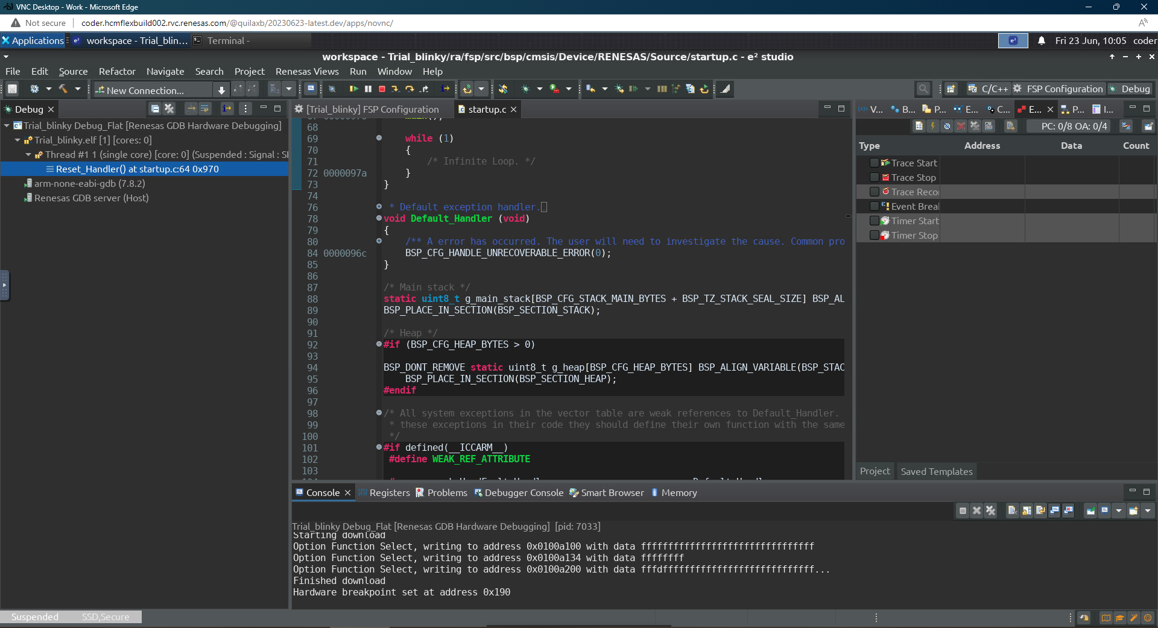
debug (by e2studio on no-vnc desktop)

Slide 31
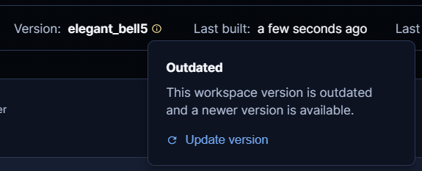
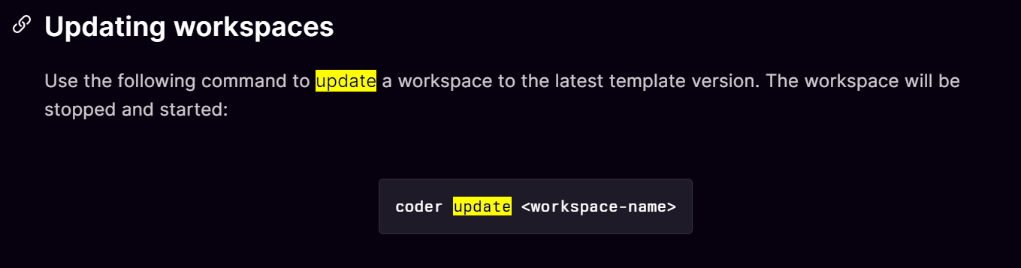

Update workspace version
On web:
CLI:
VS Code Desktop:

Slide 32
reference
2023-02-fspwg-lower-barriers-to-entry.pptx
FSP coder connect FY23-20230222.pptx
debug-local-hw-with-coder
coder-getting-started

Slide 33
appendix

Slide 34
Why use coder
Coder allows users to get quick access to FSP development environments with goals:
We need a way for developers to get started quickly
We want all developers to have latest tools
We want developers to know when tools are updated
We want to ensure some tools are installed that users might forget (eg: pre-commit hooks, git lfs)
We want developers working in a consistent manner
We don't want developers wasting time on custom dev setups
We want devs to have faster building machines than laptops with anti-virus
We want devs to have access to network licensed toolchains like AC6 and IAR

Slide 35
Why use coder
We need a way for developers to get started quickly
Docker allows everyone share a common development image
Devs do not have to install tools, setup paths, and configure tool settings
Coder allows developers to interact with the container in multiple ways.
We want all developers to have latest tools
Using Docker Images
We want developers to know when tools are updated
Coder alerts users to updates through web UI or command line interface
We want to ensure some tools are installed that users might forget (eg: pre-commit hooks, git lfs)
Have a script in the Docker Image that initializes necessary things for devs

Slide 36
Why use coder
We want developers working in a consistent manner
Add new scripts to repo that do most common activities
Add shortcuts in VS Code
We don't want developers wasting time on custom dev setups
can customize their setup(they have sudo access)
We want devs to have faster building machines than laptops with anti-virus
Our work laptops will never match a build server
We want devs to have access to network licensed toolchains like AC6 and IAR

Slide 37
Renesas.com

